Slide 1
PRESENTED BY:-
KRISHNA BHAMBANI
KANISHA DANGI
ANUPAM KHARE
ADITYA GOYAL

Slide 2
RESCUE RIDE

Slide 3
FEATURES OF RESCUE RIDE
1
2
ALARM BUTTON FOR AVOIDING UNECCESSARY WASTAGE OF RESOURCES AND TIME
DETECTS THE LOCATION OF ACCIDENT
PROVIDES IMMEDIATE MEDICAL HELP BY CONNECTING TO NEAREST HOSPITAL
PROVIDES CONNECTIVITY TO FRIEND AND FAMILY
ONE TO ONE CONNECTION BETWEEN FAMILY AND HOSPITAL
3
4
4
5

Slide 4

ALARM BUTTON
•If an accident occurs, the alarm gets activated automatically just like the airbag.
•The occupants have the option to deactivate the alarm themselves.
• If the alarm deactivated indicating that the occupants are not in the immediate need of medical assistant.
•But If they are unable to deactivate the alarm within 90 seconds then the system alerts.

Slide 5
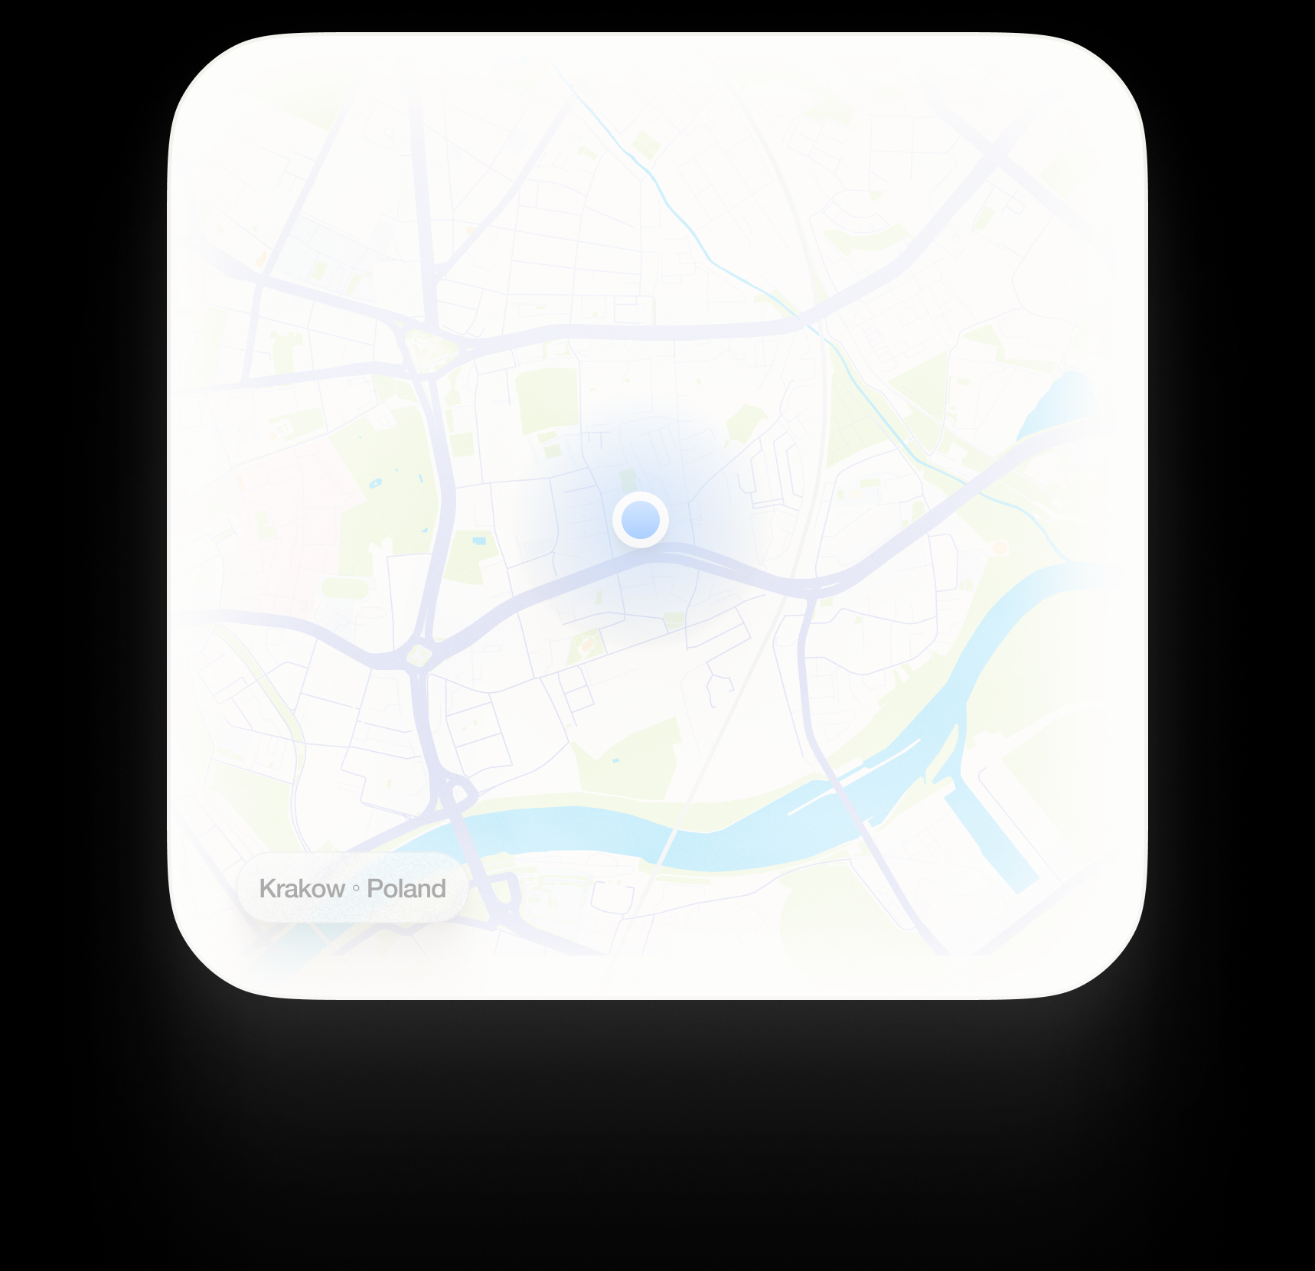
LOCATION DETECTION
We have developed our solution by integrating the car GPS tracking API, which allows us to accurately pinpoint the accident location.
Emergency contact notifications, and seamless transmission of information to the hospitals.
Seamlessly communicate with the necessary entities.
Alongside the API, we have implemented a robust system to handle the data processing.

Slide 6


CONNECTIVITY TO NEAREST HOSPITAL
Using advanced car GPS tracking technology and an integrated API, our system instantly transmits the exact location of the accident to nearby hospitals and emergency services.
This enables the medical teams to swiftly respond, arriving at the scene as quickly as possible to provide the necessary aid.
By leveraging this combination of GPS tracking, real-time communication, and integration with hospital networks, our project significantly reduces the response time during accidents, potentially saving lives and minimizing the severity of injuries.

Slide 7






CONNECTIVITY TO FRIENDS AND FAMILY
• Along with immediate medical assistance ,the system automatically sends an alert to the designated family members or emergency contacts of the occupant.
• Brings peace of mind to their families, knowing that they will be promptly notified in case of an emergency.
• aims to bridge the gap between accidents and rapid response, ultimately saving lives.

Slide 8
CONNECTION
Family members will be provided with assigned hospital details.
Similarly, Hospital will be provided with occupant’s family details.
This will ensure that the doctor can reach out to the occupant’s family for easy documentation

Slide 9


REVENUE MODEL
Our revenue model involves partnering with car manufacturers and receiving commissions for software installations in their vehicles, offering enhanced functionality and user experience.
We develop innovative software solutions for integration into car systems, providing features such as navigation, entertainment, and driver assistance technologies.
Car companies benefit from a competitive advantage, improved user experience, and additional revenue streams through premium features.
We negotiate commission structures based on the number of installations or software value, while also providing ongoing maintenance, updates, and customer support.
By scaling partnerships and exploring new vehicle segments, we tap into the growing demand for advanced software solutions, ensuring a mutually beneficial relationship between our company and car manufacturers.

Slide 10
THANK YOU

